Slide 1

Hospital Database Project in Data Management
By: Abhishek Namdev Sawant
Garrett Ringler
Vivek Reddy Karra
Sai Kishore Chintala
Erdenetuya Namsrai

Slide 2
Introduction

Slide 3
Mission
Our Hospital Management System aims to establish a comprehensive database encompassing all medical records. That included the process from a patient making an appointment, visiting the doctor, receiving detailed information about their illness, and obtaining the appropriate treatment, to the final steps of billing, health insurance management, and the storage of medical records
Enhancing the efficiency of medical services and administrative tasks
This system is designed to ease the workflow of medical staff, promote efficient duty allocation, and improve overall patient care quality

Slide 4
Problem Summary
The traditional/some management of hospital systems often suffers from segregated and uncoordinated databases, resulting in inefficient healthcare delivery
The duplication of patient records, disjointed medical records, and a lack of integration between appointments, billing, and insurance data.
This problem leads to challenges in accessing comprehensive patient histories, coordinating care, and managing hospital resources effectively

Slide 5
Database Design

Slide 6
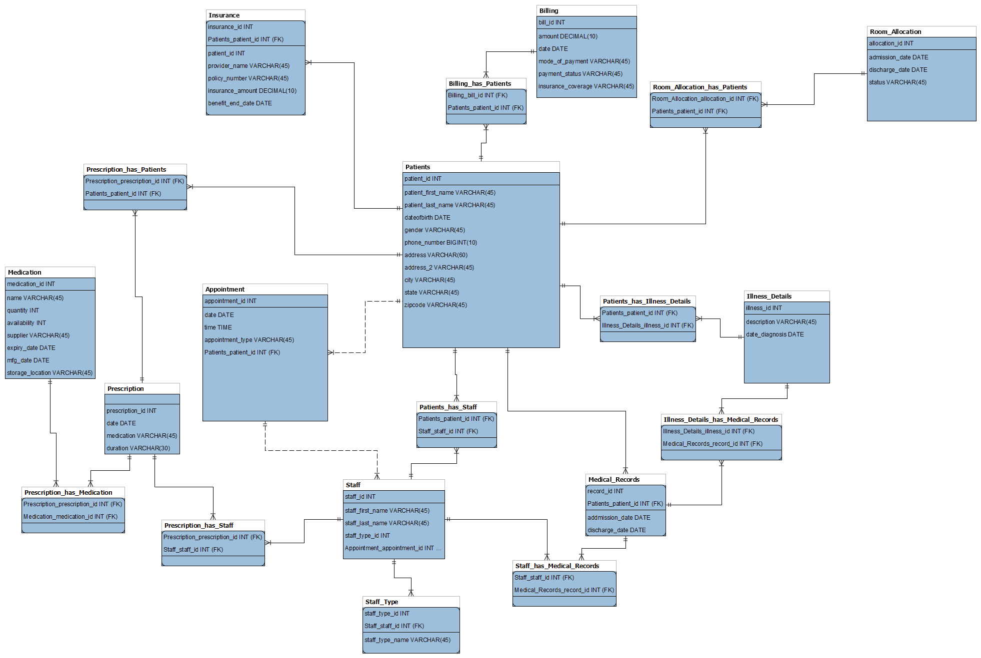
Initial ER Diagram

Slide 7
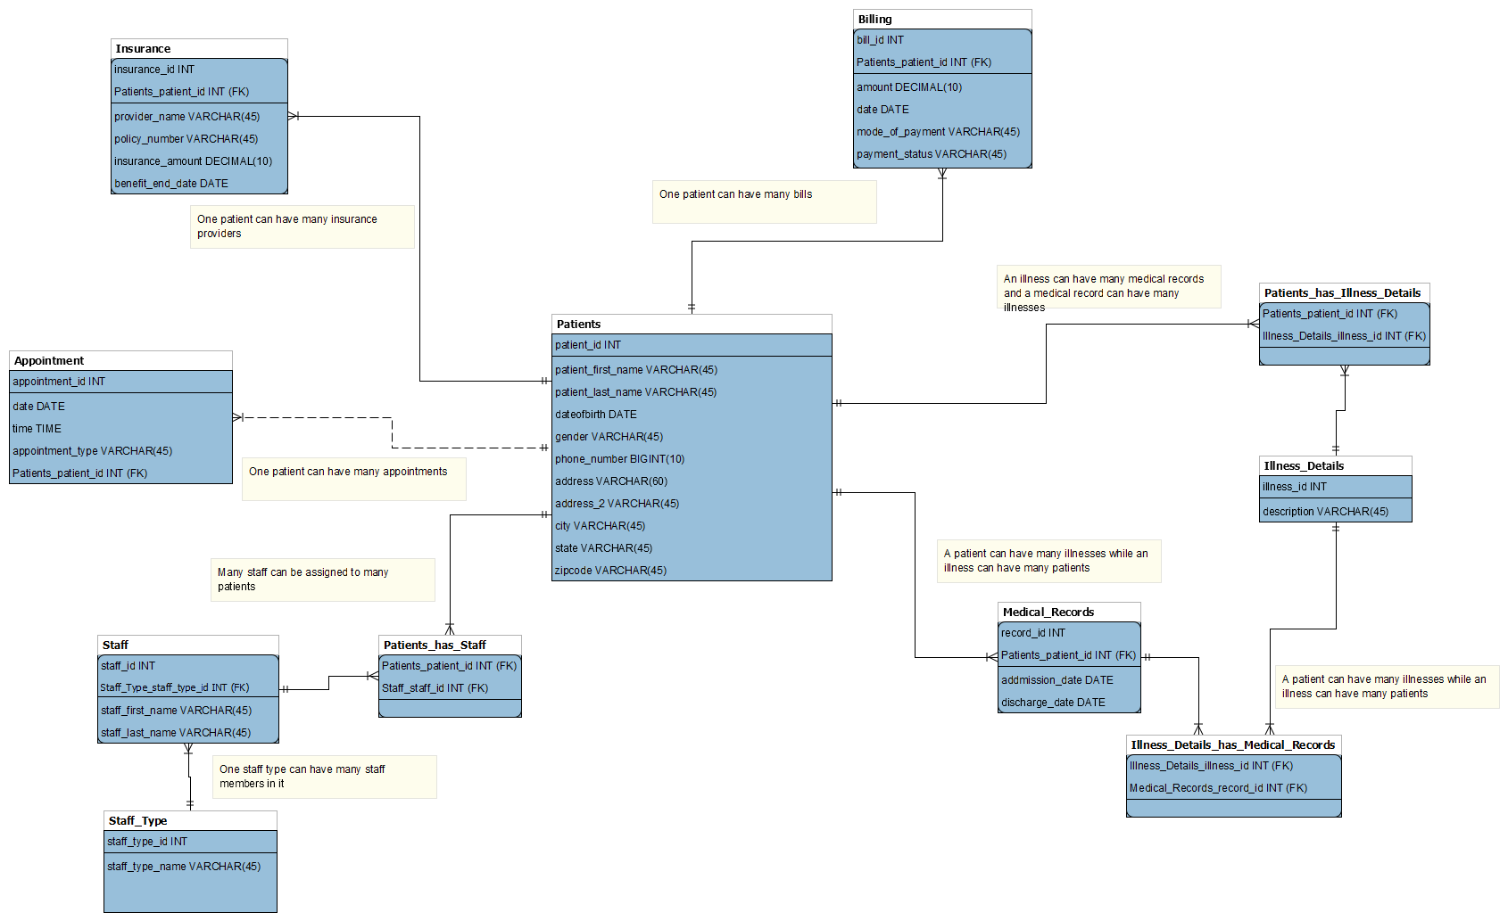
Final ER Diagram

Slide 8
Data Visualizations “Tableau”

Slide 9
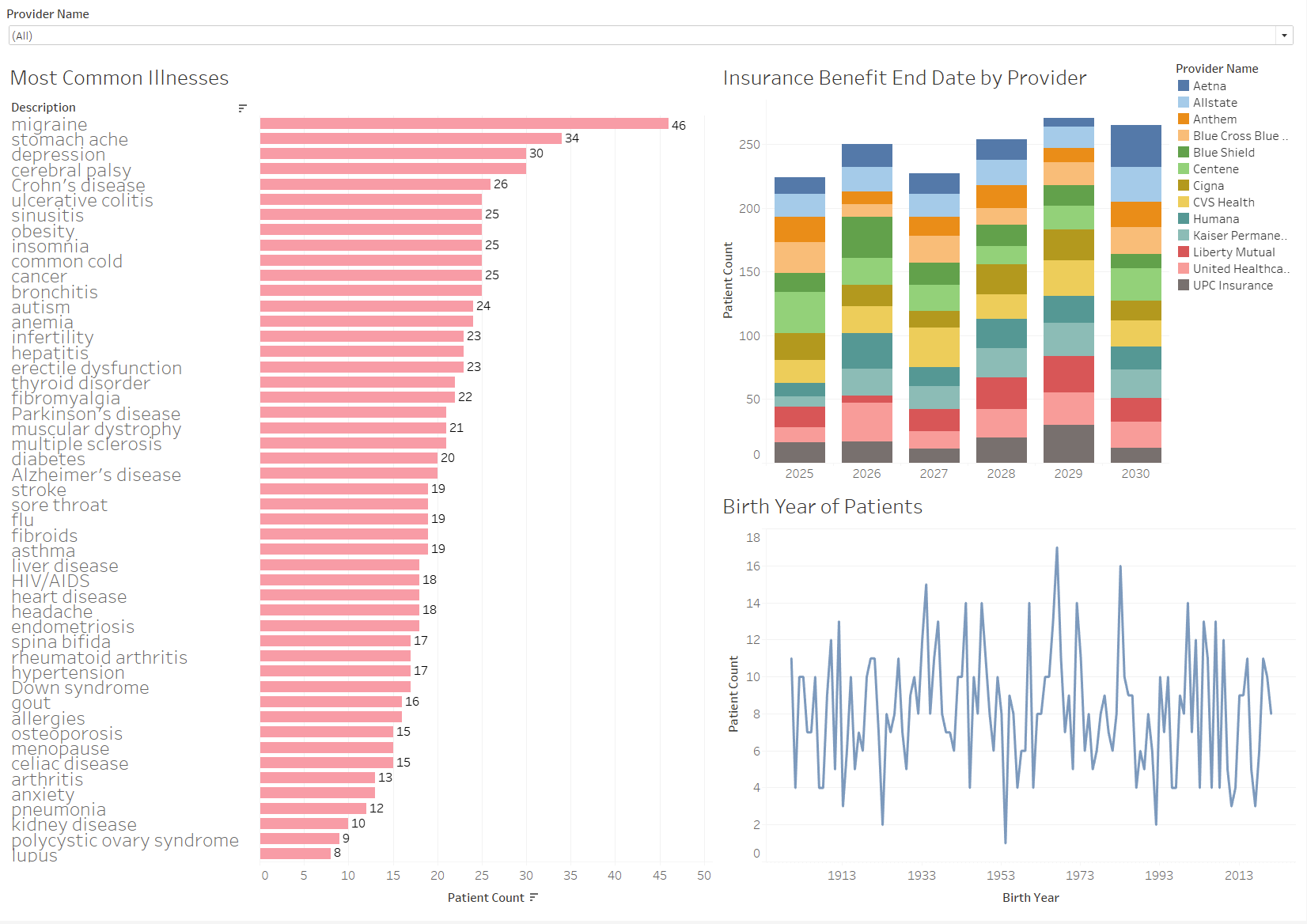

Slide 10
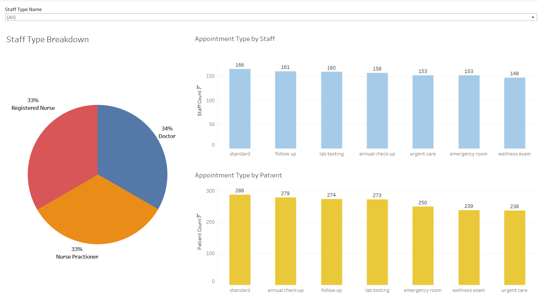

Slide 11
SQL Queries

Slide 12
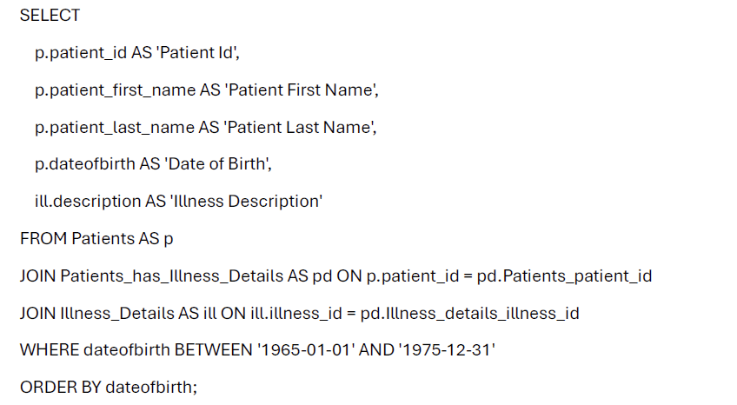
Query: Give details of patients with their illness based on their birth dates. Example: 1965 - 1975
Notes:
Query 5 from Milestone 2

Slide 13
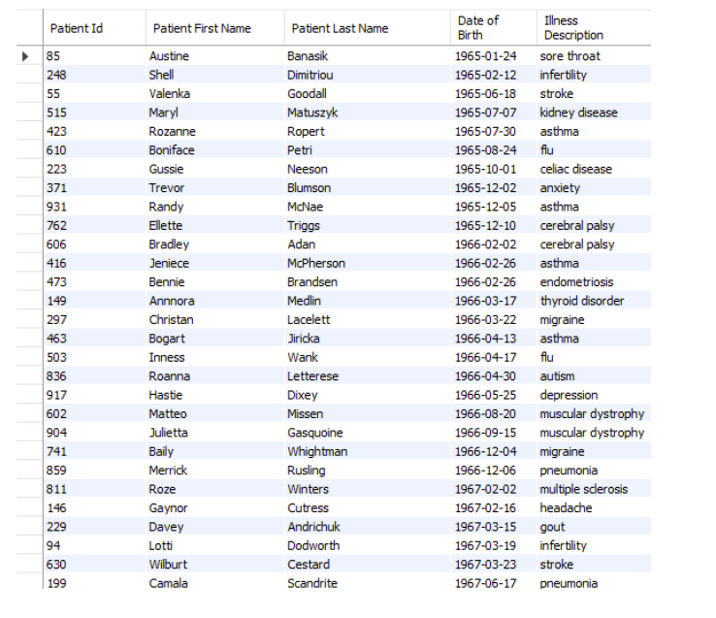
Output

Slide 14
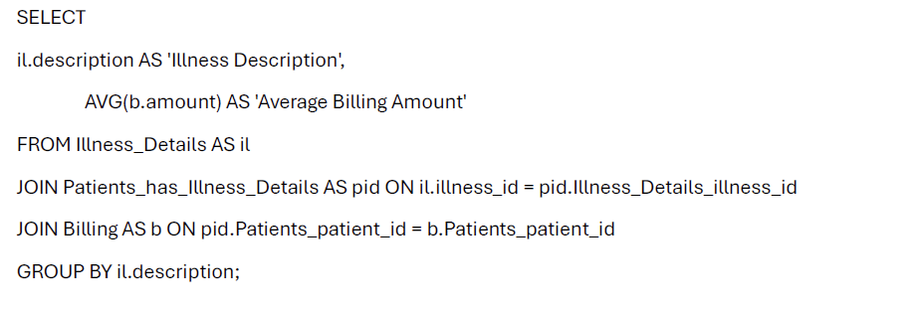
Query: What is the average billing amount per illness type?
Notes:
Query 10 from Milestone 2

Slide 15
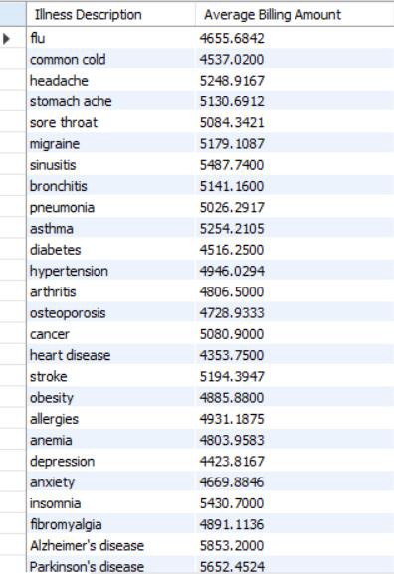
Output

Slide 16
Python Program

Slide 17
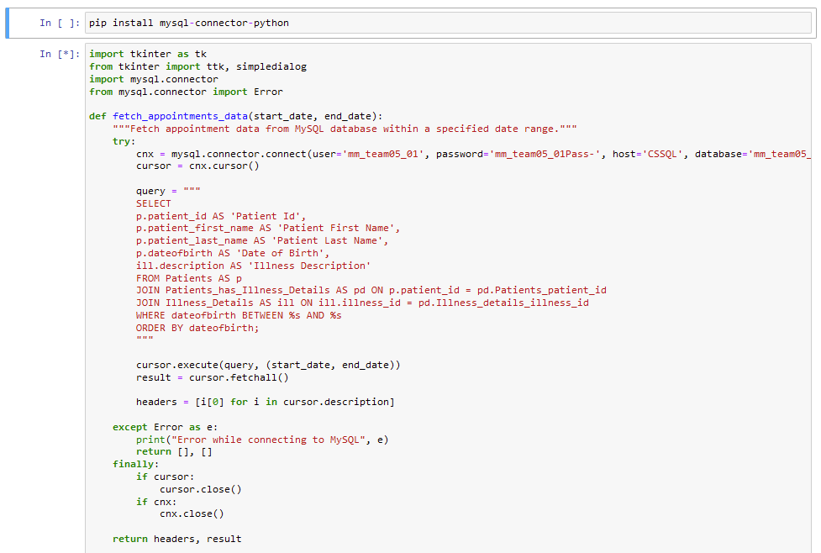
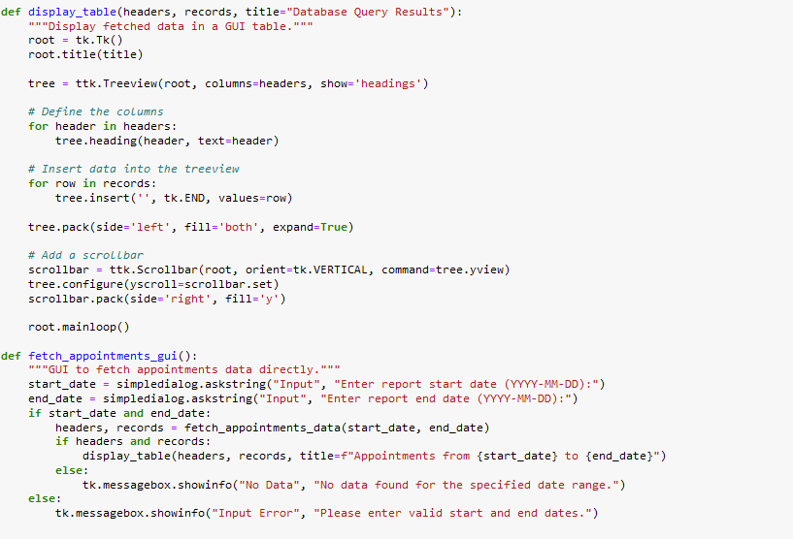
GUI Code Snapshot

Slide 18
SQL Query Parameters
Most of the queries use a reporting start and end date parameter to pull data based on a date column in the query
The Payment Status query utilizes a parameter to search for unpaid, paid in full, or payment plan

Slide 19
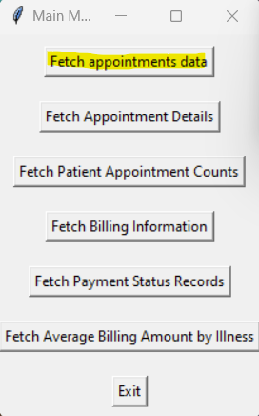
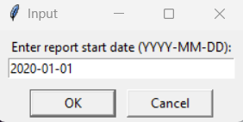
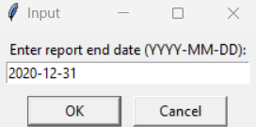
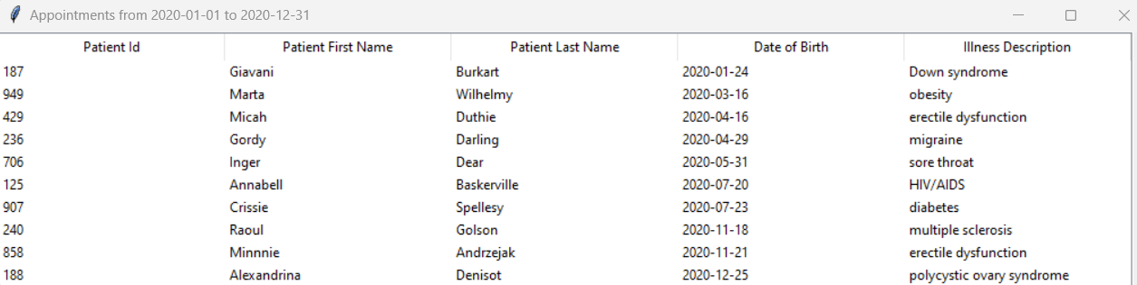
Appointment Query

Slide 20
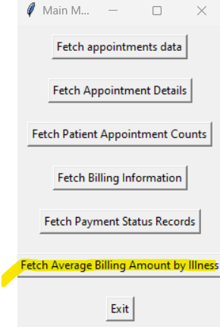
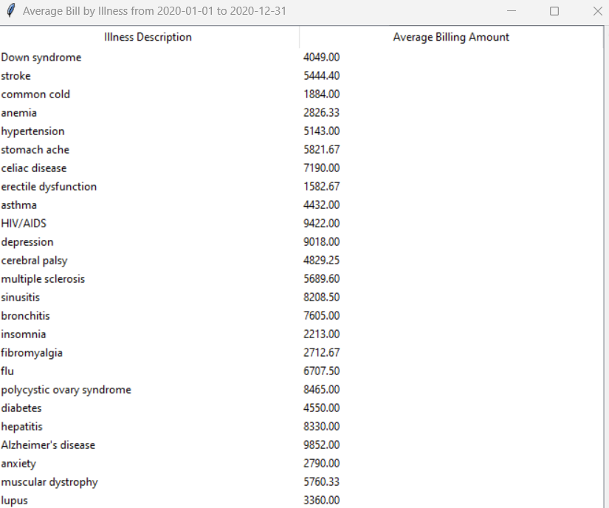
Average Bill Per Illness Query Example

Slide 21
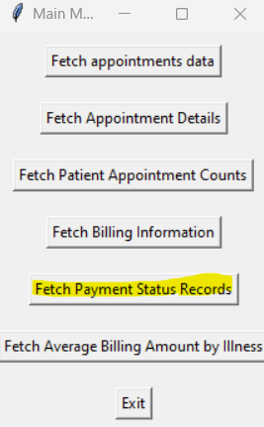
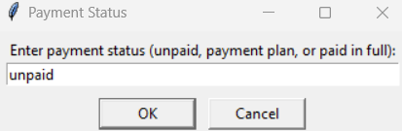
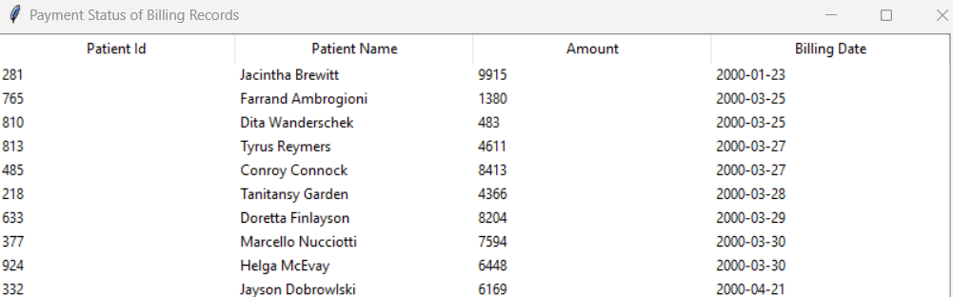
Payment Status Records Query Example

Slide 22

Thank You For Your Attention!

Slide 23
Appendix

Slide 24
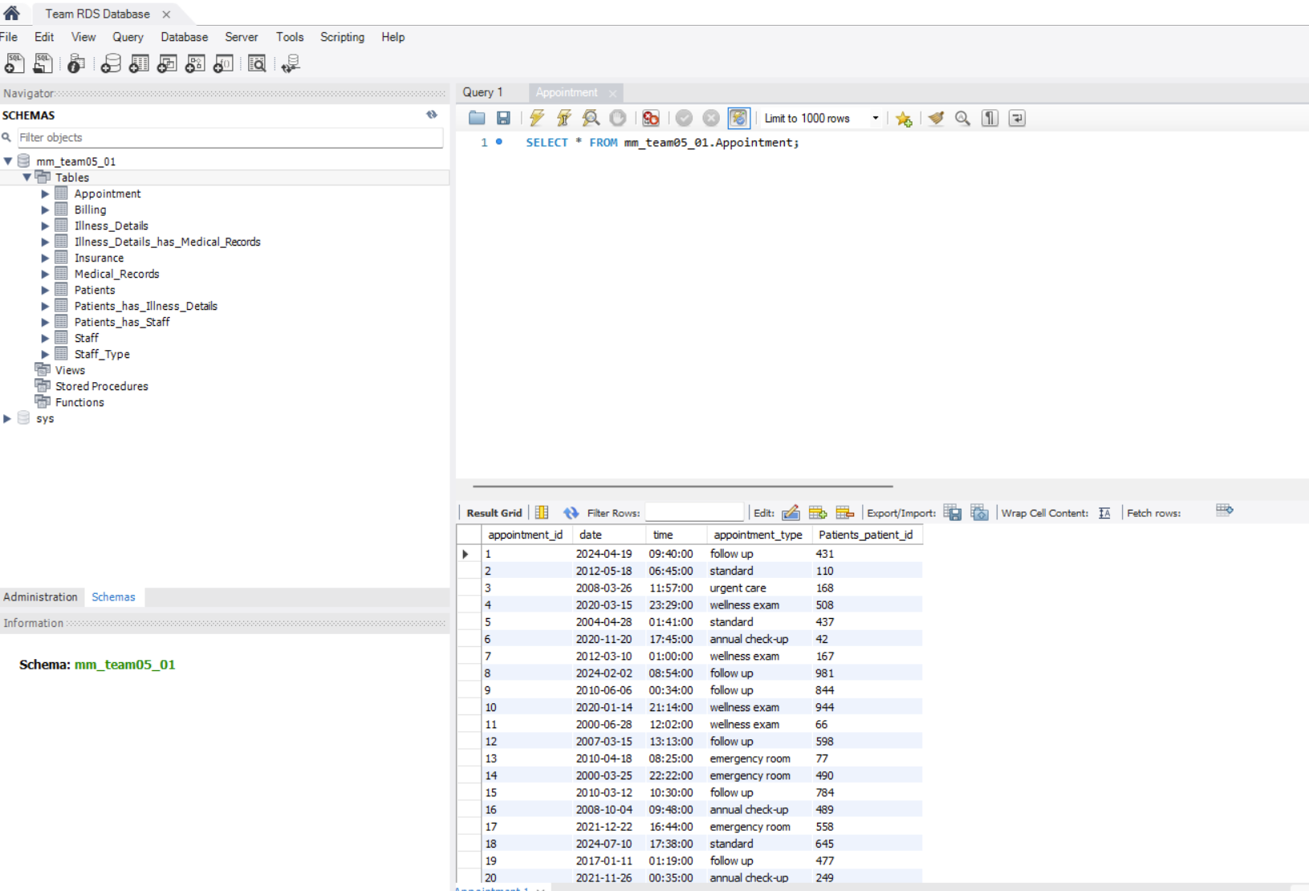
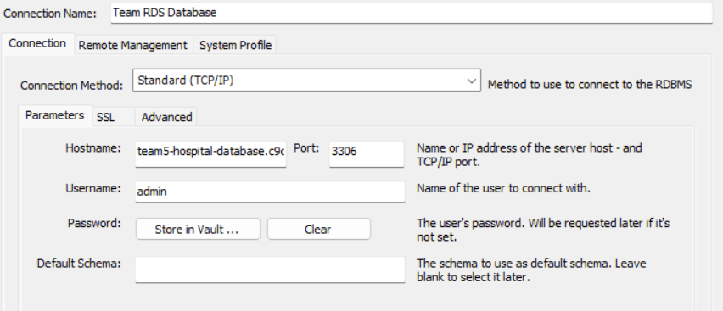
CSSQL to RDS Upload

Slide 25
RDS Login Credentials for MySQL Workbench
Hostname: team5-hospital-database.c9qsuia82i10.us-east-1.rds.amazonaws.com
Username: admin
Password: PaSsW0rD!

